Slide 1




Slide 2



Slide 3
Chapter Description

Slide 4


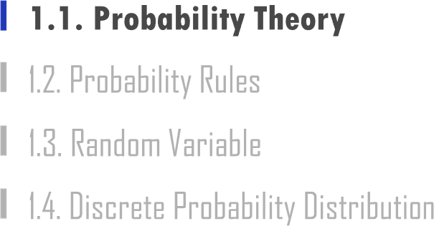

Slide 5

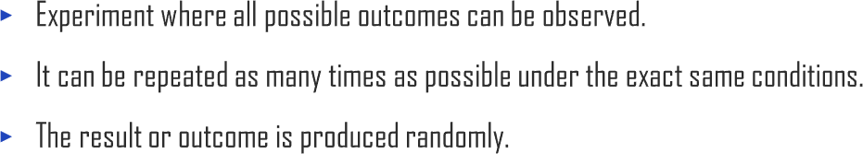


1.1. Probability Theory
UNIT 01

Slide 6

1.1. Probability Theory
UNIT 01
𝑆 = {𝑒₁, 𝑒₂, 𝑒₃, …, 𝑒_{𝑁}}
Ex
Ex

Slide 7

1.1. Probability Theory
UNIT 01
Ex
Ex Ex Ex

Slide 8

1.1. Probability Theory
UNIT 01
Ex
Ex Ex Ex Ex Ex

Slide 9
1.1. Probability Theory
UNIT 01
Ex
Ex Ex Ex

Slide 10
1.1. Probability Theory
UNIT 01
Ex
Ex Ex

Slide 11
1.1. Probability Theory
UNIT 01
𝑁_{𝐴}
𝑃 𝐴 =
𝑁

Slide 12
1.1. Probability Theory
UNIT 01
Ex
36 − 6 5
𝑃 = =
36 6
Ex
6 1
𝑃 =
=
36 6

Slide 13
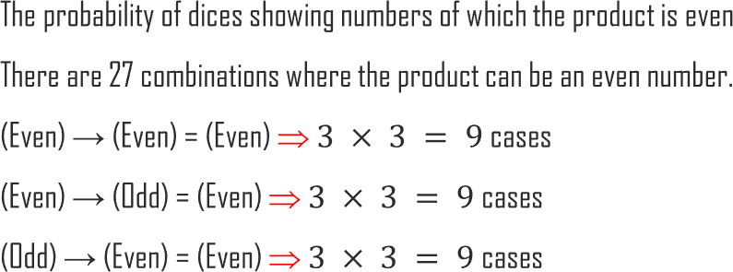
1.1. Probability Theory
UNIT 01
Ex
27 3
𝑃 =
=
36 4

Slide 14
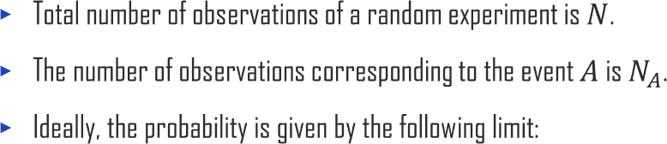
1.1. Probability Theory
UNIT 01
𝑁_{𝐴}
𝑃(𝐴) = lim
^{𝑁→∞} 𝑁
𝑁_{𝐴}
𝑃 𝐴 =
𝑁

Slide 15

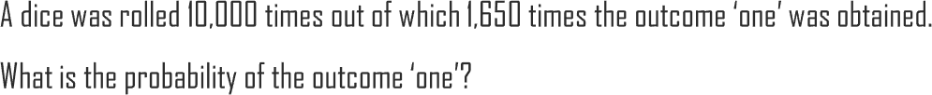
1.1. Probability Theory
UNIT 01
Ex
980
1000
𝑃 =
= 0.98
Ex
1650 1
𝑃 = = 0.165 ≈
10000 6

Slide 16

1.1. Probability Theory
UNIT 01
0 ≤ 𝑃(𝐴) ≤ 1
𝑃 𝑆 = 1
𝑃 𝜙 = 0
𝑝₁ + 𝑝₂ + ⋯ + 𝑝_{𝑁} = 1

Slide 17
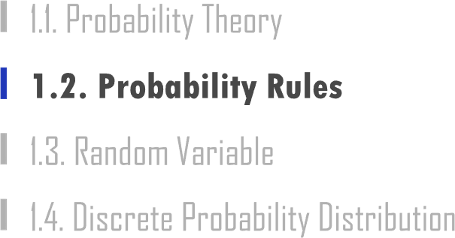

Slide 18



1.2. Probability Rules
UNIT 01
𝑃 𝐴 ∪ 𝐵= 𝑃 𝐴 + 𝑃 𝐵− 𝑃(𝐴 ∩ 𝐵)
A B

Slide 19
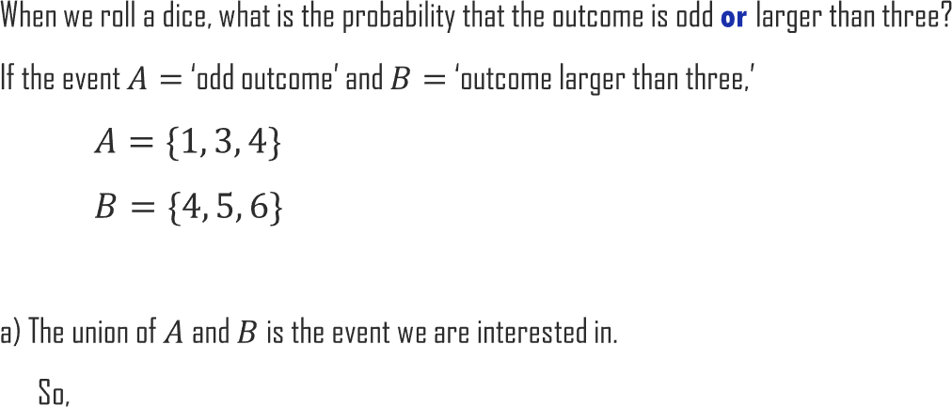
1.2. Probability Rules
UNIT 01
Ex
5
𝐴 ∪ 𝐵 = {1, 3, 4, 5, 6} → 𝑃 𝐴 ∪ 𝐵 =
6

Slide 20
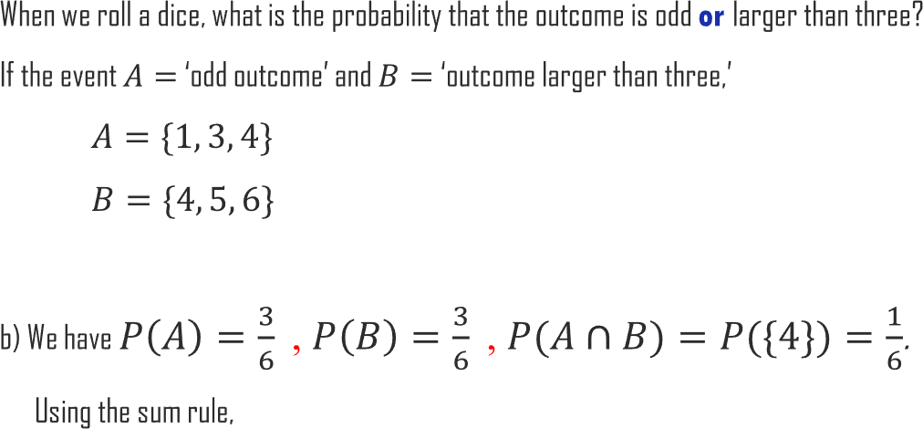
1.2. Probability Rules
UNIT 01
Ex
3 3 1 5
𝑃 𝐴 ∪ 𝐵 = 𝑃 𝐴 + 𝑃 𝐵 − P(𝐴 ∩ 𝐵) = + – =
6 6 6 6

Slide 21
1.2. Probability Rules
UNIT 01
𝑃(𝐴 ∪ 𝐵) = 𝑃(𝐴) + 𝑃(𝐵)
A B

Slide 22
1.2. Probability Rules
UNIT 01
𝑃(𝐴 ∪ 𝐵 ∪ 𝐶) = 𝑃(𝐴) + 𝑃(𝐵) + 𝑃(𝐶)
A
B
C

Slide 23
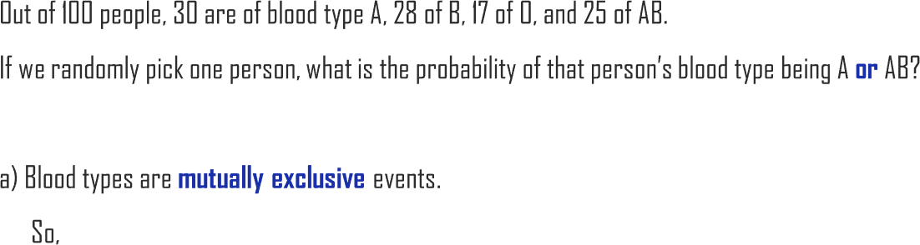
1.2. Probability Rules
UNIT 01
Ex
30 25 11
𝑃 𝐴 ∪ 𝐴𝐵 = 𝑃 𝐴 + 𝑃 𝐴𝐵 =
+ =
100 100 20

Slide 24


1.2. Probability Rules
UNIT 01
𝐴 ∪ 𝐴^{𝑐} = 𝑆 ⇒
⇒
𝑃 𝐴 + 𝑃 𝐴^{𝑐} = 1
𝑃 𝐴 = 1 − 𝑃 𝐴^{𝑐}
A

Slide 25
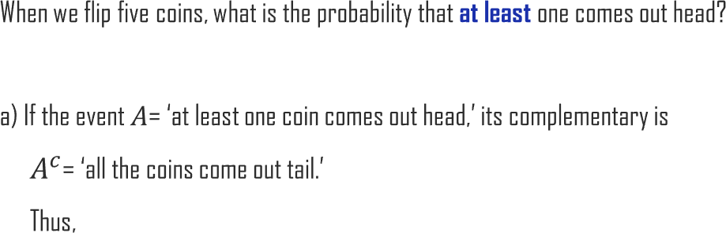

1.2. Probability Rules
UNIT 01
Ex
𝑃 𝐴^{𝑐} = ¹ = ¹
₂5
32
𝑃 𝐴 = 1 − 𝑃 𝐴^{𝑐} = 1 − ¹ = ³¹
32 32

Slide 26
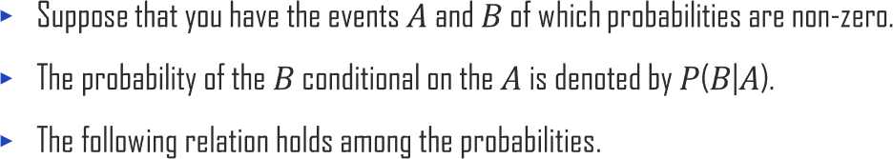
1.2. Probability Rules
UNIT 01
A
B
𝑃(𝐴 ∩ 𝐵)
𝑃 𝐵|𝐴 =
𝑃(𝐴)
𝑃 𝐴 ∩ 𝐵 = 𝑃 𝐴|𝐵 𝑃 𝐵
= 𝑃 𝐵|𝐴 𝑃 𝐴

Slide 27

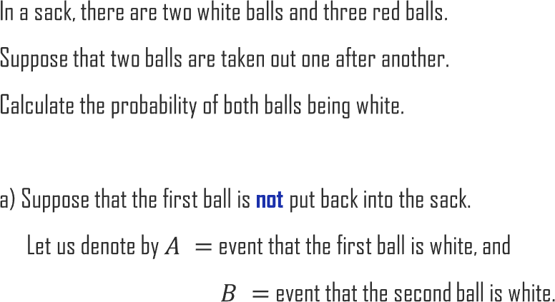
1.2. Probability Rules
UNIT 01
Ex
1 2 1
𝑃 𝐴 ∩ 𝐵 = 𝑃 𝐵 𝐴 𝑃(𝐴) = × =
4 5 10

Slide 28
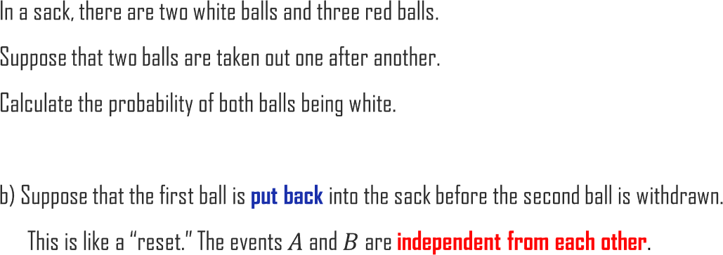
1.2. Probability Rules
UNIT 01
Ex
2 2 4
𝑃 𝐴 ∩ 𝐵 = 𝑃 𝐵 𝐴 𝑃 𝐴 = 𝑃 𝐵 𝑃 𝐴 = × =
5 5 25

Slide 29
1.2. Probability Rules
UNIT 01
𝑃 𝐴 ∩ 𝐵 = 𝑃 𝐴|𝐵 𝑃 𝐵
= 𝑃 𝐵|𝐴 𝑃 𝐴
and
𝑃 𝐴 ∩ 𝐵 ≠ 𝑃 𝐴 𝑃 𝐵
𝑃 𝐴 ∩ 𝐵 = 𝑃 𝐵 𝑃 𝐴
𝑃 𝐴 ∩ 𝐵 = 0

Slide 30

1.2. Probability Rules
UNIT 01
𝑃 𝐴 ∩ 𝐵 = 𝑃 𝐴|𝐵 𝑃 𝐵
= 𝑃 𝐵|𝐴 𝑃 𝐴
𝑃 𝐴|𝐵 𝑃 𝐵 = 𝑃 𝐵|𝐴 𝑃 𝐴

Slide 31
1.2. Probability Rules
UNIT 01
𝑃 𝐴|𝐵 𝑃 𝐵 = 𝑃 𝐵|𝐴 𝑃 𝐴
𝑃 𝐵|𝐴 𝑃 𝐴
𝑃 𝐴|𝐵 =
𝑃(𝐵)
𝑃 𝐵|𝐴 𝑃 𝐴
=
𝑃 𝐵|𝐴 𝑃 𝐴 + 𝑃 𝐵|𝐴^{𝑐} 𝑃 𝐴^{𝑐}

Slide 32
1.2. Probability Rules
UNIT 01
𝑃 𝐵|𝐴 𝑃 𝐴
𝑃 𝐴|𝐵 =
𝑃 𝐵|𝐴 𝑃 𝐴 + 𝑃 𝐵|𝐴^{𝑐} 𝑃 𝐴^{𝑐}

Slide 33



1.2. Probability Rules
UNIT 01
𝑃 𝐵|𝐴 𝑃 𝐴
𝑃 𝐴|𝐵 =
𝑃 𝐵|𝐴 𝑃 𝐴 + 𝑃 𝐵|𝐴^{𝑐} 𝑃 𝐴^{𝑐}
A
B
A
B

Slide 34


1.2. Probability Rules
UNIT 01
𝑃 𝐵|𝐴 𝑃 𝐴
𝑃 𝐴|𝐵 =
𝑃 𝐵|𝐴 𝑃 𝐴 + 𝑃 𝐵|𝐴^{𝑐} 𝑃 𝐴^{𝑐}
A
B

Slide 35

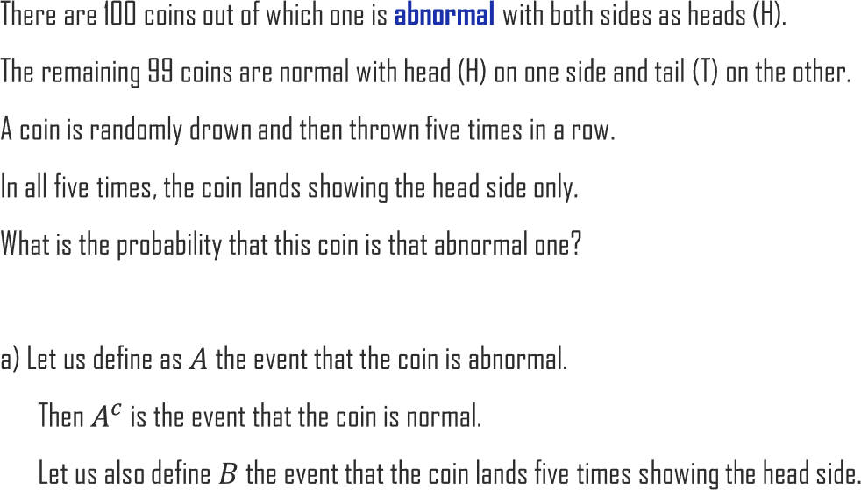
1.2. Probability Rules
UNIT 01
Ex

Slide 36
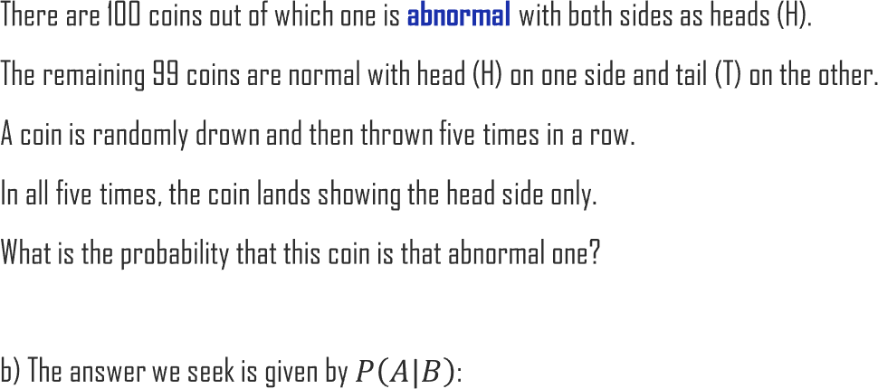
1.2. Probability Rules
UNIT 01
Ex
𝑃 𝐵|𝐴 𝑃 𝐴
𝑃 𝐵|𝐴 𝑃 𝐴 + 𝑃 𝐵|𝐴^{𝑐} 𝑃 𝐴^{𝑐}
_{1 ×} 1
𝑃 𝐴|𝐵 =
= ¹⁰⁰ ≅ 𝟎. 𝟐𝟒𝟒
5
1 1 99
1 × ₁₀₀ +
2 × 100

Slide 37

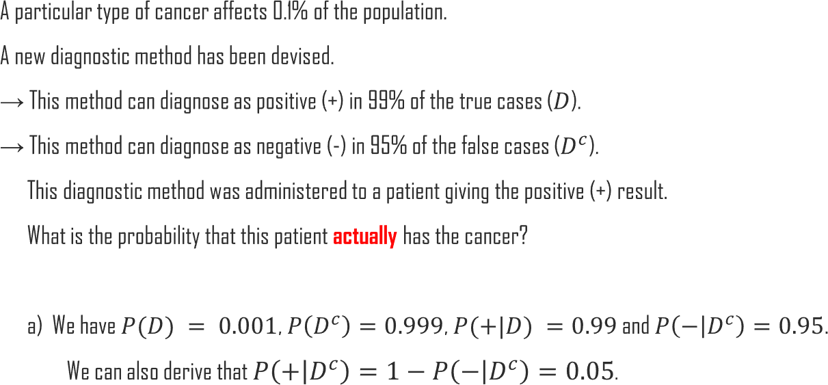
1.2. Probability Rules
UNIT 01
Ex

Slide 38
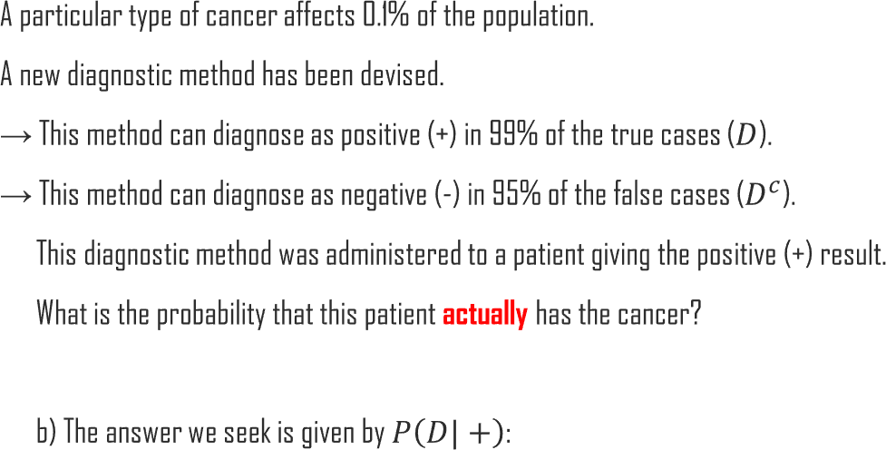


1.2. Probability Rules
UNIT 01
Ex
𝑃 +|𝐷 𝑃 𝐷 0.99 × 0.001
⁼ 𝑃 +|𝐷 𝑃 𝐷 + 𝑃 +|𝐷^{𝑐} 𝑃 𝐷^{𝑐 =} 0.99 × 0.001 + 0.05 × 0.999 ^{≅ 𝟎. 𝟎𝟐}
𝑃 𝐷| +

Slide 39
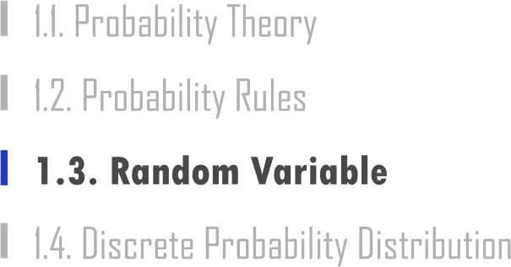

Slide 40

1.3. Random Variable
UNIT 01
Ex
Ex
Ex
Ex
Ex

Slide 41
1.3. Random Variable
UNIT 01
Ex

Slide 42
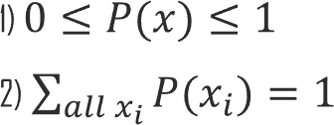
1.3. Random Variable
UNIT 01

Slide 43

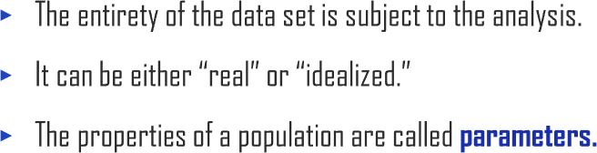


1.3. Random Variable
UNIT 01
Ex
Ex

Slide 44

1.3. Random Variable
UNIT 01

Slide 45


1.3. Random Variable
UNIT 01
𝜇 = 𝐸[𝑋] = ෍ 𝑥 𝑃(𝑥)
𝑎𝑙𝑙 𝑥
𝜇 = 𝐸[𝑋] = න 𝑥 𝑓 𝑥 𝑑𝑥

Slide 46
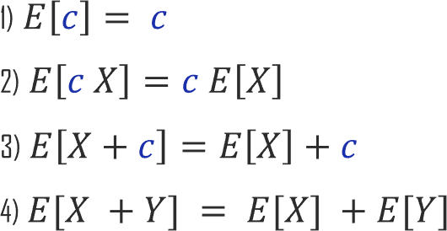
1.3. Random Variable
UNIT 01

Slide 47


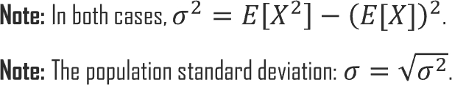
1.3. Random Variable
UNIT 01
𝜎² = 𝑉𝑎𝑟(𝑋) = ෍ 𝑥 − 𝜇 ² 𝑃(𝑥)
𝑎𝑙𝑙 𝑥
𝜎² = 𝑉𝑎𝑟(𝑋) = න 𝑥 − 𝜇 ²𝑓 𝑥 𝑑𝑥

Slide 48
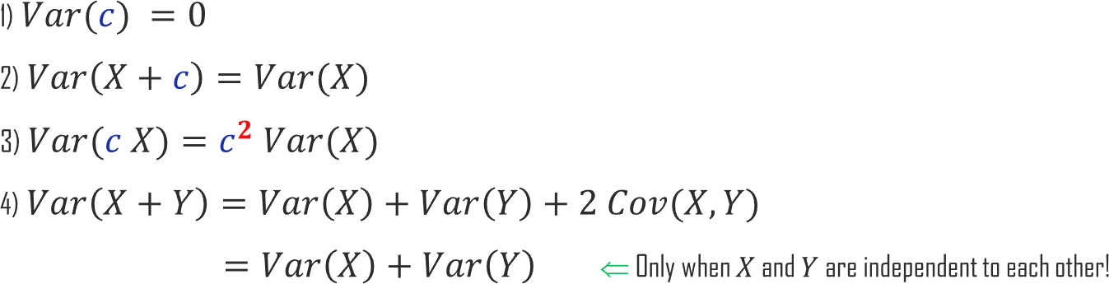
1.3. Random Variable
UNIT 01

Slide 49
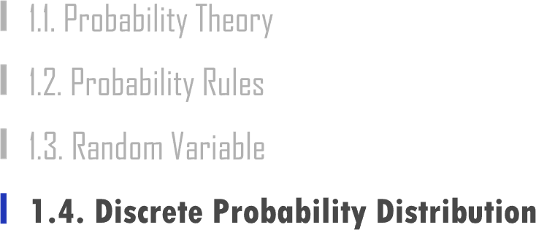

Slide 50

1.4. Discrete Probability Distribution
UNIT 01

Slide 51



1.4. Discrete Probability Distribution
UNIT 01
Ex
1
2
1
2

Slide 52
1.4. Discrete Probability Distribution
UNIT 01
Ex
𝑝
(1 − 𝑝)

Slide 53
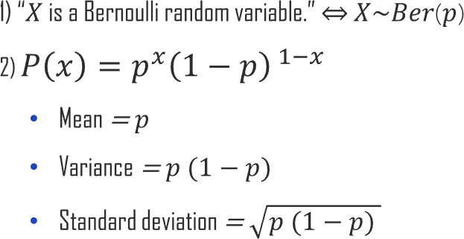
1.4. Discrete Probability Distribution
UNIT 01

Slide 54

1.4. Discrete Probability Distribution
UNIT 01

Slide 55
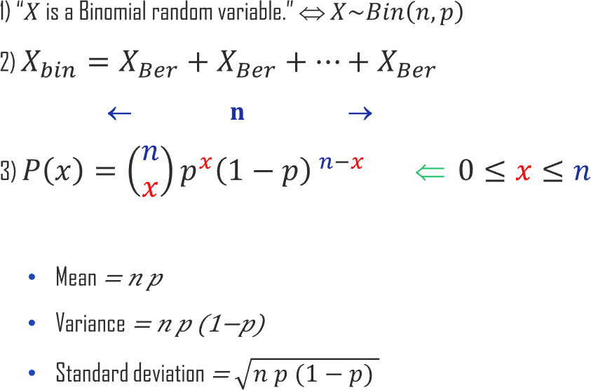
1.4. Discrete Probability Distribution
UNIT 01

Slide 56
1.4. Discrete Probability Distribution
UNIT 01
𝑛 = 10, 𝑝 = 0.5

Slide 57
1.4. Discrete Probability Distribution
UNIT 01
𝑛 = 10, 𝑝 = 0.3

Slide 58
1.4. Discrete Probability Distribution
UNIT 01
𝑛 = 10, 𝑝 = 0.7

Slide 59


1.4. Discrete Probability Distribution
UNIT 01
Ex
𝑃 0 =
5
0
0.2⁰ 1 − 0.2
5−0 ₌
5! ₅ ₅
_{0! 5!} 0.8 = 0.8 = 0.328

Slide 60


1.4. Discrete Probability Distribution
UNIT 01
Ex
𝑃 2 =
5
2
0.2² 1 − 0.2
5−2 ₌
^{5!} 2 3 2 3
_{2! 3!} 0.2 × 0.8 = 10 × 0.2 × 0.8 = 0.205

Slide 61


1.4. Discrete Probability Distribution
UNIT 01
Ex
𝑃 𝑋 ≤ 2 = 𝑃 0 + 𝑃 1 + 𝑃 2
=
5
0
0.2⁰ 1 − 0.2
5−0 ₊
5
1
0.2¹ 1 − 0.2
5−1 ₊
5
2
0.2² 1 − 0.2
5−2
= 1 × 1 × 0.8⁵ + 5 × 0.2 × 0.8⁴ + 10 × 0.2²× 0.8³
= 0.328 + 0.41 + 0.205
= 0.942

Slide 62

1.4. Discrete Probability Distribution
UNIT 01
Ex
Ex Ex

Slide 63
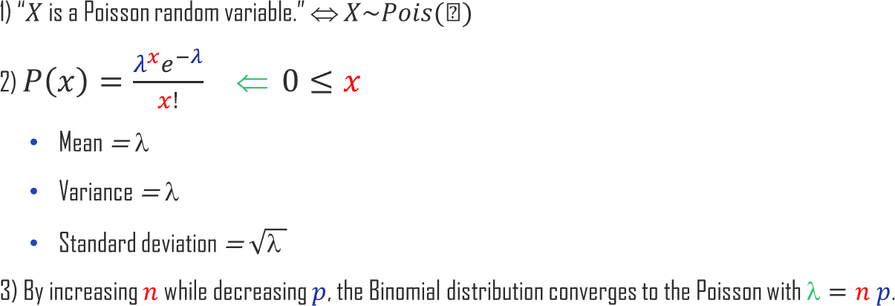
1.4. Discrete Probability Distribution
UNIT 01

Slide 64
1.4. Discrete Probability Distribution
UNIT 01
𝑙𝑎𝑚𝑏𝑑𝑎 = 2

Slide 65
1.4. Discrete Probability Distribution
UNIT 01
𝑙𝑎𝑚𝑏𝑑𝑎 = 4

Slide 66
1.4. Discrete Probability Distribution
UNIT 01
𝑙𝑎𝑚𝑏𝑑𝑎 = 6

Slide 67
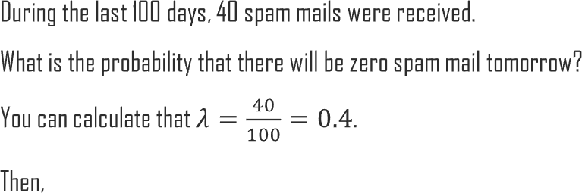

1.4. Discrete Probability Distribution
UNIT 01
Ex
_{0.4}0_{𝑒}−0.4
0!
𝑃 0 =
= 𝑒^{−0.4} = 0.6703

Slide 68
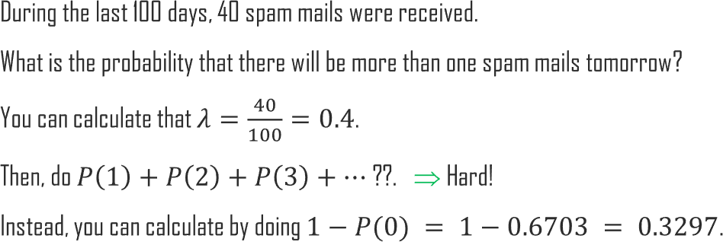
1.4. Discrete Probability Distribution
UNIT 01
Ex

Slide 69


1.4. Discrete Probability Distribution
UNIT 01

Slide 70

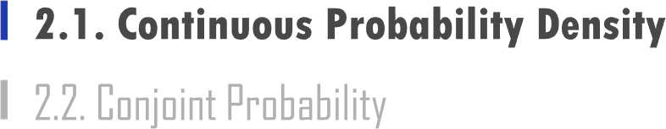

Slide 71
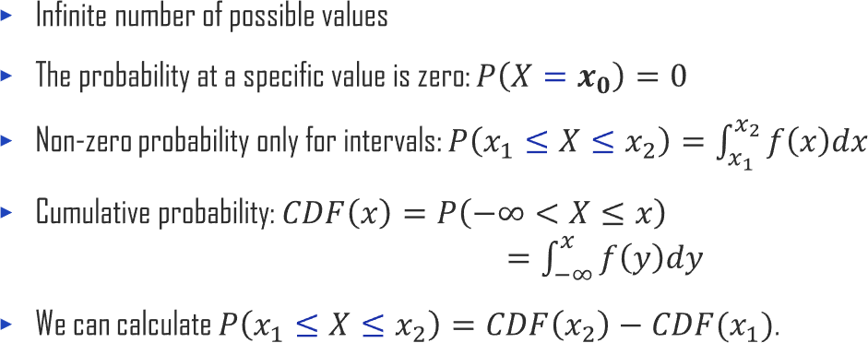
2.1. Continuous Probability Density
UNIT 02

Slide 72
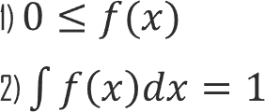
2.1. Continuous Probability Density
UNIT 02

Slide 73
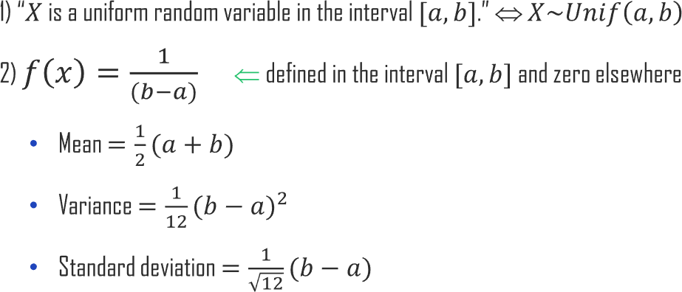
2.1. Continuous Probability Density
UNIT 02

Slide 74

2.1. Continuous Probability Density
UNIT 02
Ex
𝑓 𝑥 𝐶𝐷𝐹 𝑥

Slide 75
2.1. Continuous Probability Density
UNIT 02
Ex
15000
𝑃 12000 ≤ 𝑋 ≤ 15000 = න
12000
1
20000 − 10000 ^{𝑑𝑥 = 0.3}

Slide 76

2.1. Continuous Probability Density
UNIT 02
Ex
20000
𝑃 15000 ≤ 𝑋 ≤ 20000 = න
15000
1
20000 − 10000 ^{𝑑𝑥 = 0.5}

Slide 77
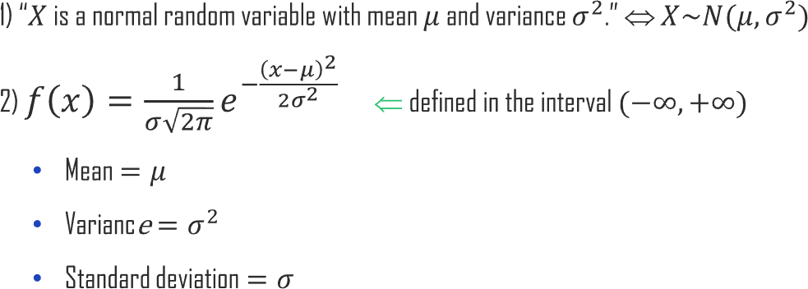
2.1. Continuous Probability Density
UNIT 02

Slide 78



2.1. Continuous Probability Density
UNIT 02

Slide 79
2.1. Continuous Probability Density
UNIT 02

Slide 80
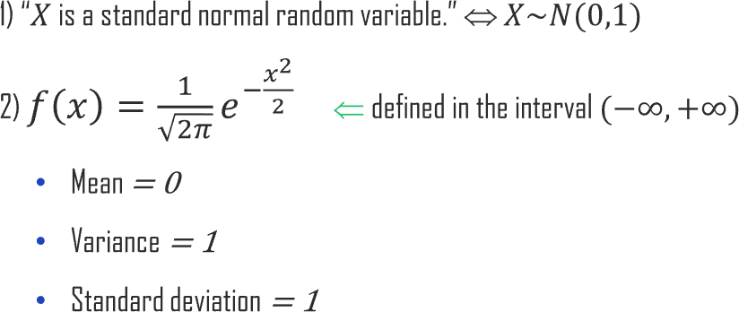
2.1. Continuous Probability Density
UNIT 02

Slide 81

2.1. Continuous Probability Density
UNIT 02
1) 𝑋 + 𝑌 ~ 𝑁 𝜇₁ + 𝜇₂ , 𝜎² + 𝜎²
1 2
2) 𝑋 − 𝑌 ~ 𝑁( 𝜇₁ − 𝜇₂ , 𝜎² + 𝜎²)
1 2

Slide 82
2.1. Continuous Probability Density
UNIT 02
𝑓 𝑥 𝐶𝐷𝐹 𝑥

Slide 83
2.1. Continuous Probability Density
UNIT 02
𝑋 − 𝜇
𝑍 =
𝜎
𝑥 − 𝜇
z−score =
𝜎
𝑋 = 𝜎 𝑍 + 𝜇

Slide 84
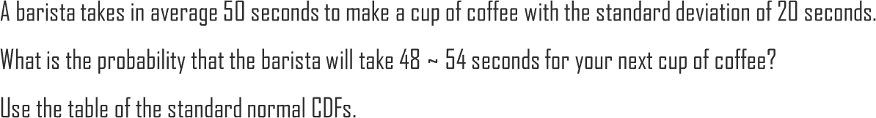

2.1. Continuous Probability Density
UNIT 02
Ex
1) First of all, let us standardize:
𝑥₁ − 𝜇 48 − 50 2
= = = − = −0.1
𝑥₁ = 48 ⇒ 𝑧₁
𝜎 20 20
𝑥₂ − 𝜇 54 − 50 4
= = = = 0.2
𝑥₂ = 54 ⇒ 𝑧₂
𝜎
20
20

Slide 85

2.1. Continuous Probability Density
UNIT 02
Ex
2) 𝑃 𝑧₁ ≤ 𝑍 ≤ 𝑧₂ = 𝐶𝐷𝐹 𝑧₂ − 𝐶𝐷𝐹 𝑧₁
= 𝐶𝐷𝐹 0.2 − 𝐶𝐷𝐹 −0.1
= 0.5793 − 0.4602 = 0.1191

Slide 86
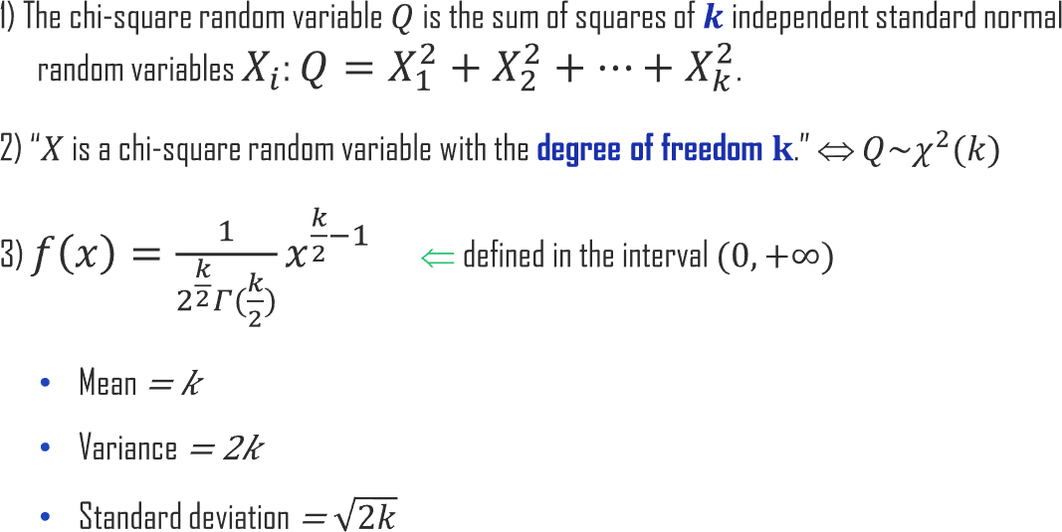
2.1. Continuous Probability Density
UNIT 02

Slide 87
2.1. Continuous Probability Density
UNIT 02

Slide 88
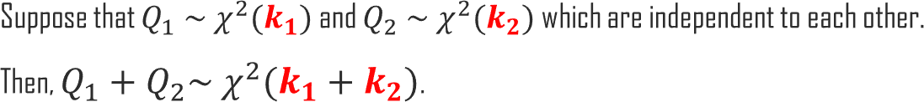

2.1. Continuous Probability Density
UNIT 02
𝑄₁ + 𝑄₂ = 𝑋² + 𝑋² + ⋯ + 𝑋² + 𝑋² + ⋯ + 𝑋²
← 𝒌_{𝟏} → ← 𝒌_{𝟐} →

Slide 89
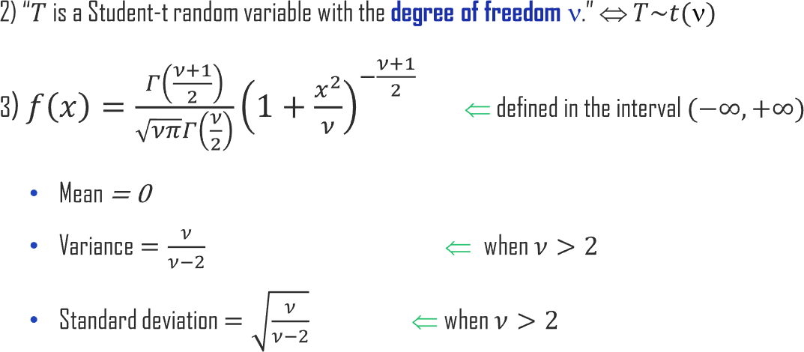
2.1. Continuous Probability Density
UNIT 02
𝑍
𝑇 =
𝑄/ν

Slide 90
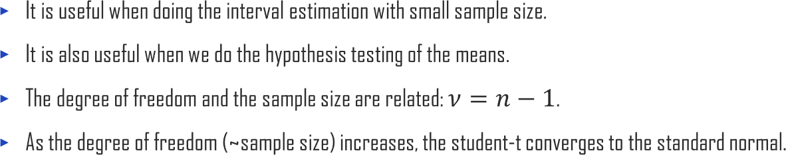
2.1. Continuous Probability Density
UNIT 02

Slide 91

2.1. Continuous Probability Density
UNIT 02

Slide 92
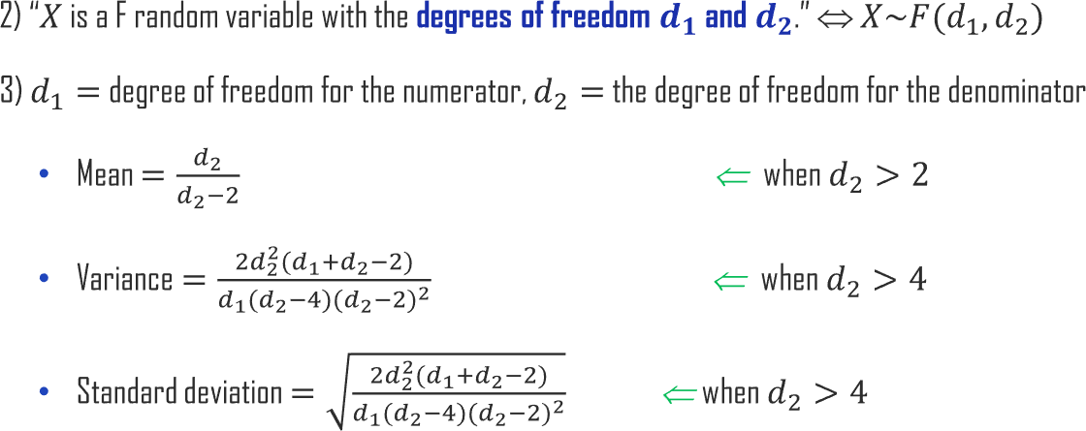
2.1. Continuous Probability Density
UNIT 02
𝑄_{1ൗ𝑑}
𝑋 =
1
𝑄_{2ൗ𝑑}
2

Slide 93
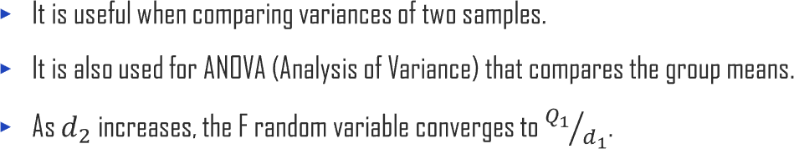
2.1. Continuous Probability Density
UNIT 02

Slide 94



2.1. Continuous Probability Density
UNIT 02

Slide 95

2.1. Continuous Probability Density
UNIT 02

Slide 96
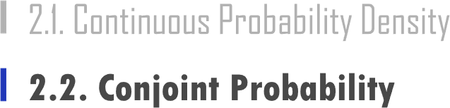

Slide 97

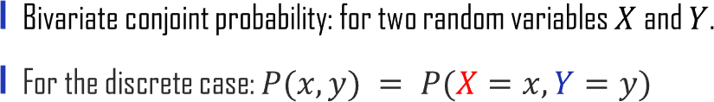
2.2. Conjoint Probability
UNIT 02

Slide 98

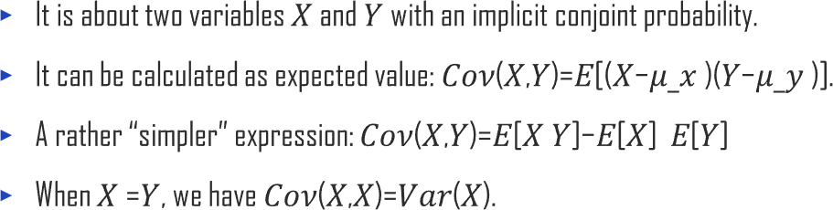
2.2. Conjoint Probability
UNIT 02

Slide 99

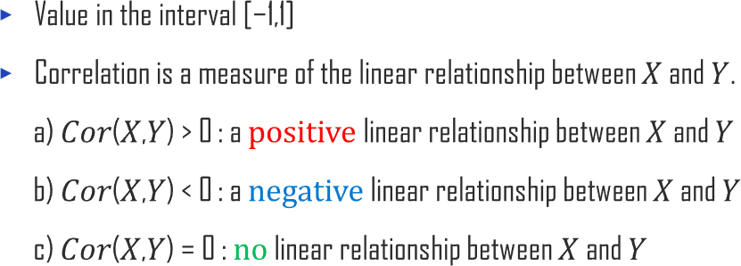
2.2. Conjoint Probability
UNIT 02
𝐶𝑜𝑣(𝑋, 𝑌)
𝐶𝑜𝑟(𝑋,𝑌)=
𝜎_{𝑋}𝜎_{𝑌}

Slide 100


2.2. Conjoint Probability
UNIT 02

Slide 101


2.2. Conjoint Probability
UNIT 02

Slide 102


2.2. Conjoint Probability
UNIT 02

Slide 103
2.2. Conjoint Probability
UNIT 02

Slide 104

2.2. Conjoint Probability
UNIT 02

Slide 105

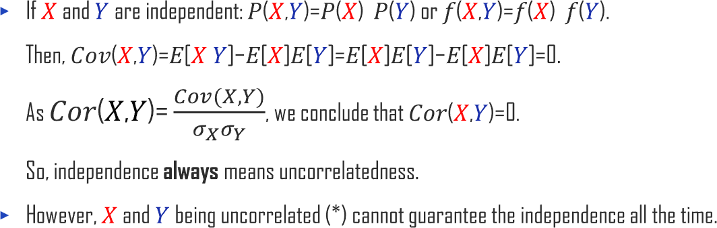

2.2. Conjoint Probability
UNIT 02

Slide 106
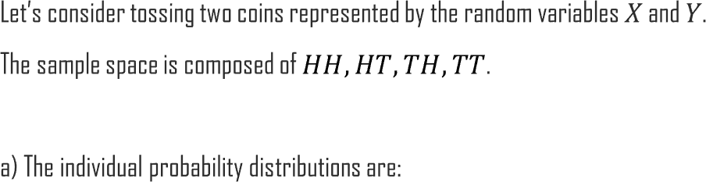


2.2. Conjoint Probability
UNIT 02
Ex
1
𝑃(𝑋=𝐻)= ₂
1
𝑃(𝑋=𝑇)= ₂
1
𝑃(𝑌=𝐻)= ₂
1
𝑃(𝑌=𝑇)= ₂

Slide 107
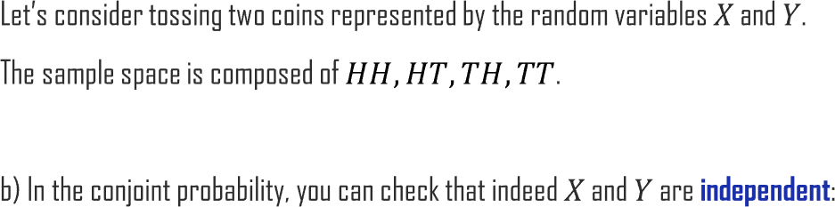
2.2. Conjoint Probability
UNIT 02
Ex
1
𝑃(𝑋=𝐻, 𝑌=𝐻)= =𝑃(𝑋=𝐻)×𝑃(𝑌=𝐻)
4
1
𝑃(𝑋=𝐻, 𝑌=𝑇)= =𝑃(𝑋=𝐻)×𝑃(𝑌=𝑇)
4
1
𝑃(𝑋=𝑇, 𝑌=𝐻)= =𝑃(𝑋=𝑇)×𝑃(𝑌=𝐻)
4
1
𝑃(𝑋=𝑇, 𝑌=𝑇)= =𝑃(𝑋=𝑇)×𝑃(𝑌=𝑇)
4

Slide 108
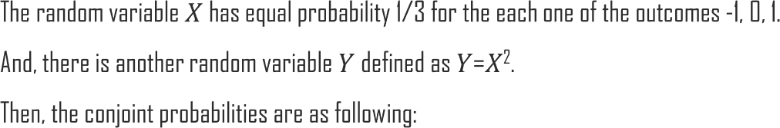
2.2. Conjoint Probability
UNIT 02
Ex
1
3
1
1
3
𝑃(𝑋 =−1, 𝑌 =1) =
, 𝑃(𝑋 =0, 𝑌 =0)= , 𝑃(𝑋 = 1, 𝑌 =1)=
3
1
1
𝐸[𝑋]=−1×𝑃(𝑋=−1)+0×𝑃(𝑋=0)+1×𝑃(𝑋=1)=− +0+ =0
3
3
2 2
𝐸[𝑌]=0×𝑃(𝑌=0)+1×𝑃(𝑌=1)=0+1× =
3 3
𝐸[𝑋 𝑌]=𝐸[𝑋 𝑋² ]=𝐸[𝑋³ ]=−1×𝑃(𝑋=−1)+0×𝑃(𝑋=0)+1×𝑃(𝑋=1)=0
So, 𝐶𝑜𝑣(𝑋,𝑌)=𝐸[𝑋 𝑌]−𝐸[𝑋] 𝐸[𝑌]=0−0× ² =0 and 𝐶𝑜𝑟(𝑋,𝑌) = 0, too.
3

Slide 109
2.2. Conjoint Probability
UNIT 02
Ex
1
1
1
3
𝑃(𝑋 =−1, 𝑌 =1) = , 𝑃(𝑋 =0, 𝑌 =0) = , 𝑃(𝑋 = 1, 𝑌 =1) =
3
3
𝑃(𝑋 = −1, 𝑌 = 1)= ¹ ≠𝑃(𝑋=−1)×𝑃(𝑌=1)= ¹ × ² = ²
3 3 3 9
1
3
1 × 1 ₌ 1
3 3 9
1 × 2 2
3 3 9
𝑃(𝑋 =0, 𝑌 =0)=
≠𝑃(𝑋=0)×𝑃(𝑌=0)=
1
𝑃(𝑋 =1, 𝑌 =1)= ≠𝑃(𝑋=1)×𝑃(𝑌=1)=
=
3
Summarizing 𝑃(𝑋,𝑌)≠𝑃(𝑋)𝑃(𝑌) so that X and Y are not independent.
Here, we found a case where 𝑋 and 𝑌 are uncorrelated but not independent!

Slide 110



Slide 111





3.1. Descriptive Statistics
UNIT 03

Slide 112



3.1. Descriptive Statistics
UNIT 03

Slide 113



3.1. Descriptive Statistics
UNIT 03

Slide 114

3.1. Descriptive Statistics
UNIT 03
2 s
𝑥ഥ = 𝑚
𝜍 = 0

Slide 115

3.1. Descriptive Statistics
UNIT 03
𝑥ഥ 𝑚
𝜍 < 0

Slide 116
3.1. Descriptive Statistics
UNIT 03
𝑚 𝑥ഥ
𝜍 > 0

Slide 117
3.1. Descriptive Statistics
UNIT 03
𝜅 < 0 𝜅 > 0

Slide 118

3.1. Descriptive Statistics
UNIT 03

Slide 119

3.1. Descriptive Statistics
UNIT 03
^{𝑥}70
^{𝑥}𝑁−1
𝑥₃
𝑥₂
𝑥_{𝑁}
𝑥₁

Slide 120
3.1. Descriptive Statistics
UNIT 03
^{𝑥}(𝑁)
^{𝑥}(62)
^{𝑥}(4)
^{𝑥}(3)
_{𝑥(1)} ^{𝑥}(2)

Slide 121

3.1. Descriptive Statistics
UNIT 03
Range = Maximum − Minimum

Slide 122

3.1. Descriptive Statistics
UNIT 03
Q3 + 1.5 ×IQR
Q3
IQR
Median
Q1
Q1 - 1.5 × IQR

Slide 123

3.1. Descriptive Statistics
UNIT 03

Slide 124


Slide 125



3.2. Central Limit Theorem
UNIT 03

Slide 126


3.2. Central Limit Theorem
UNIT 03

Slide 127









3.2. Central Limit Theorem
UNIT 03

Slide 128


3.2. Central Limit Theorem
UNIT 03
Ex

Slide 129

3.2. Central Limit Theorem
UNIT 03
Ex

Slide 130

3.2. Central Limit Theorem
UNIT 03
𝑛 = 2
𝑛 = 5
𝑛 = 10
𝑛 = 50

Slide 131



3.2. Central Limit Theorem
UNIT 03
_{𝜎}2
=
𝑛
𝑝(1 − 𝑝) 0.25
=
𝑛 𝑛
2
Var(𝑋 ) = 𝜎 =
ത
𝑋
𝜎
𝜎_{𝑋ത} = _{𝑛} =
𝑝(1 − 𝑝) 0.5
=
𝑛 𝑛

Slide 132


3.2. Central Limit Theorem
UNIT 03

Slide 133


3.2. Central Limit Theorem
UNIT 03

Slide 134





3.2. Central Limit Theorem
UNIT 03
𝑋 − 𝜇
𝜎
𝑍 =
ൗ _{𝑛}
𝑋 − 𝜇
𝑠
𝑡 =
ൗ
𝑛

Slide 135


3.2. Central Limit Theorem
UNIT 03
a) Expected value: 𝐸 𝑃෢ = 𝑝
𝜎 ₌ 𝑝(1−𝑝)
𝑛 𝑛
b) Standard error: 𝜎 ෡ =
𝑃

Slide 136
3.2. Central Limit Theorem
UNIT 03
a) Expected value: 𝐸 𝑋₁ − 𝑋₂ = 𝐸 𝑋₁] − 𝐸[𝑋₂ = 𝜇₁ − 𝜇₂
b) Standard error: 𝜎 =
_{𝜎}2
+ 𝜎² =
2 2
𝜎₁ ₊ 𝜎₂
𝑋₁−𝑋₂
𝑋₁
𝑋₂
𝑛₁ 𝑛₂

Slide 137














3.2. Central Limit Theorem
UNIT 03
 |  | and

Slide 138


Slide 139



3.3. Estimation Theory
UNIT 03
Ex

Slide 140


3.3. Estimation Theory
UNIT 03

Slide 141



3.3. Estimation Theory
UNIT 03
Ex
Ex

Slide 142

3.3. Estimation Theory
UNIT 03
𝐸 𝜃෠₁ = 𝜃 , 𝐸 𝜃෠₂ = 𝜃 , 𝐸 𝜃෠₃ = 𝜃 , …
Ex

Slide 143

3.3. Estimation Theory
UNIT 03
Ex
_{σ}^{𝑛} 2 _{σ}^{𝑛} 2
𝑥_{𝑖} − 𝑥ഥ 𝑥_{𝑖} − 𝑥ഥ
𝑖=1 ≅ 𝑖=1
𝒏
𝒏 − 𝟏

Slide 144


3.3. Estimation Theory
UNIT 03

Slide 145




3.3. Estimation Theory
UNIT 03
𝑃 −1.96 < 𝑍 < 1.96 = 0.95
𝑋^{ത} − 𝜇
ൗ _{𝑛}
𝑃 −1.96 < _{𝜎}
< 1.96 = 0.95
𝑃 −1.96 ^{𝜎}
ൗ
_{𝑛} < 𝑋^{ത} − 𝜇 < 1.96 ^{𝜎}
ൗ _{𝑛}
= 0.95

Slide 146


3.3. Estimation Theory
UNIT 03
𝑃 −1.96 ^{𝜎}
ൗ _{𝑛}
< 𝑋^{ത} − 𝜇 < 1.96 ^{𝜎}
ൗ
_{𝑛} = 0.95
𝑃 −𝑋^{ത} − 1.96 ^{𝜎}
ൗ
_{𝑛} < −𝜇 < −𝑋^{ത} + 1.96 ^{𝜎}
ൗ _{𝑛}
= 0.95
𝑃 𝑋^{ത} − 1.96 ^{𝜎}
ൗ
_{𝑛} ≤ 𝜇 ≤ 𝑋^{ത} + 1.96 ^{𝜎}
ൗ _{𝑛}
= 0.95

Slide 147
3.3. Estimation Theory
UNIT 03
Lower bound: 𝑋^{ത} − 1.96 ^{𝜎}_{ൗ 𝑛}
Upper bound: 𝑋^{ത} + 1.96 ^{𝜎}_{ൗ 𝑛}
[
← Confidence Interval →
]

Slide 148







3.3. Estimation Theory
UNIT 03

Slide 149




3.3. Estimation Theory
UNIT 03

Slide 150
3.3. Estimation Theory
UNIT 03
Lower bound: 𝑋^{ത} − 𝑧₁₋ ^{𝛼 𝜎}_{ൗ 𝑛}
Upper bound: 𝑋^{ത} + 𝑧₁₋^{𝛼 𝜎}_{ൗ 𝑛}
2
2
[
← Confidence Interval →
]
Lower bound: 𝑋^{ത} − 𝑡₁₋ ^{𝛼 𝑠}_{ൗ 𝑛}
Upper bound: 𝑋^{ത} + 𝑡₁₋^{𝛼 𝑠}_{ൗ 𝑛}
2
2
[
← Confidence Interval →
]

Slide 151

3.3. Estimation Theory
UNIT 03

Slide 152

3.3. Estimation Theory
UNIT 03

Slide 153

3.3. Estimation Theory
UNIT 03

Slide 154

3.3. Estimation Theory
UNIT 03
𝑋^{ത} ± 𝑧 ^{𝛼} ×
𝜎
𝑛
or 𝑋^{ത} ± 𝑡 ^{𝛼} ×
𝑠
𝑛
1−₂
1−₂
𝜎
^{𝒛}𝟏−𝜶/𝟐^{×𝝈 𝟐}
𝑾
𝑧 × = 𝑊 ⇒
𝒏 =
1−^{𝛼}
𝑛
2

Slide 155

3.3. Estimation Theory
UNIT 03

Slide 156

3.3. Estimation Theory
UNIT 03

Slide 157

3.3. Estimation Theory
UNIT 03

Slide 158

3.3. Estimation Theory
UNIT 03

Slide 159
3.3. Estimation Theory
UNIT 03
𝑡𝑎𝑛ℎ 𝑧 − 𝑧₁₋^{𝛼} × 𝜎_{𝑧}
𝑡𝑎𝑛ℎ 𝑧 + 𝑧₁₋^{𝛼} × 𝜎_{𝑧}
2
2
[
← Confidence Interval →
]
Ex

Slide 160

3.3. Estimation Theory
UNIT 03

Slide 161



Slide 162

4.1. Principles of Hypothesis Testing
UNIT 04
Ex
Ex

Slide 163








4.1. Principles of Hypothesis Testing
UNIT 04

Slide 164

4.1. Principles of Hypothesis Testing
UNIT 04

Slide 165

4.1. Principles of Hypothesis Testing
UNIT 04

Slide 166

4.1. Principles of Hypothesis Testing
UNIT 04

Slide 167




4.1. Principles of Hypothesis Testing
UNIT 04

Slide 168
4.1. Principles of Hypothesis Testing
UNIT 04

Slide 169










4.1. Principles of Hypothesis Testing
UNIT 04

Slide 170


Slide 171






4.2. Hypothesis Testing in Action
UNIT 04
𝑿^{ഥ}, 𝒔^{𝟐}, 𝒏
Compare 𝜇 with a specified
number 𝜇₀.
𝑥ഥ − 𝜇₀
ൗ _{𝑛}
𝑡 =
𝑠

Slide 172



4.2. Hypothesis Testing in Action
UNIT 04
𝐻₀ : 𝜇 ≤ 𝜇₀
𝐻₁ : 𝜇 > 𝜇₀
“larger”

Slide 173


4.2. Hypothesis Testing in Action
UNIT 04
𝐻₀ : 𝜇 ≥ 𝜇₀
𝐻₁ : 𝜇 < 𝜇₀
“smaller”

Slide 174
4.2. Hypothesis Testing in Action
UNIT 04
𝐻₀ : 𝜇 = 𝜇₀
𝐻₁ : 𝜇 ≠ 𝜇₀
“different”

Slide 175







4.2. Hypothesis Testing in Action
UNIT 04
𝑿^{ഥ}_{𝟏}, 𝒔^{𝟐}
𝑿^{ഥ}_{𝟐}, 𝒔^{𝟐}
,𝒏_{𝟏}
𝟏
,𝒏_{𝟐}
𝟐
Compare 𝜇₁ with 𝜇₂.

Slide 176





4.2. Hypothesis Testing in Action
UNIT 04
You should consider two cases:
Equal variances.
Unequal variances.

Slide 177



4.2. Hypothesis Testing in Action
UNIT 04
One on one pairing
Ex

Slide 178


4.2. Hypothesis Testing in Action
UNIT 04

Slide 179

4.2. Hypothesis Testing in Action
UNIT 04

Slide 180

4.2. Hypothesis Testing in Action
UNIT 04

Slide 181

4.2. Hypothesis Testing in Action
UNIT 04
𝑘
𝑡𝑒𝑠𝑡 𝑠𝑡𝑎𝑡𝑖𝑠𝑡𝑖𝑐 = ෍
𝑖=1
𝑂_{𝑖} − 𝐸_{𝑖}
𝐸_{𝑖}
2

Slide 182

4.2. Hypothesis Testing in Action
UNIT 04
Ex

Slide 183

4.2. Hypothesis Testing in Action
UNIT 04
𝑟 𝑐
^{𝑂}𝑖𝑗 ^{− 𝐸}𝑖𝑗
^{𝐸}𝑖𝑗
2
𝑡𝑒𝑠𝑡 𝑠𝑡𝑎𝑡𝑖𝑠𝑡𝑖𝑐 = ෍ ෍
𝑖=1 𝑗=1

Slide 184

4.2. Hypothesis Testing in Action
UNIT 04

Slide 185

4.2. Hypothesis Testing in Action
UNIT 04

Slide 186
4.2. Hypothesis Testing in Action
UNIT 04
𝑿^{ഥ}, 𝒔^{𝟐}, 𝒏
Compare 𝜎² with a specified number 𝜎₀².

Slide 187


4.2. Hypothesis Testing in Action
UNIT 04
(𝑛 − 1)𝑆²
𝑡𝑒𝑠𝑡 𝑠𝑡𝑎𝑡𝑖𝑠𝑡𝑖𝑐 =
_{𝜎}2
0

Slide 188

4.2. Hypothesis Testing in Action
UNIT 04

Slide 189


4.2. Hypothesis Testing in Action
UNIT 04
𝑿^{ഥ}_{𝟏}, 𝒔^{𝟐}
𝑿^{ഥ}_{𝟐}, 𝒔^{𝟐}
,𝒏_{𝟏}
𝟏
,𝒏_{𝟐}
𝟐
Compare 𝜎₁² with 𝜎₂².

Slide 190

4.2. Hypothesis Testing in Action
UNIT 04
_{𝑆}2
𝑡𝑒𝑠𝑡 𝑠𝑡𝑎𝑡𝑖𝑠𝑡𝑖𝑐 =
1
_{𝑆}2
2

Slide 191





4.2. Hypothesis Testing in Action
UNIT 04

Slide 192

4.2. Hypothesis Testing in Action
UNIT 04

Slide 193

4.2. Hypothesis Testing in Action
UNIT 04

Slide 194



Slide 195


